Slide 1

ALY 6010 Data Management & Big Data
United Kingdom Road Accident Analysis
Project By:
Dishali Sonawane
Anuj Golesar
Guided By:
Prof Sergiy Shevchenko

Slide 2
Project Statement
Analysis of the United kingdom dataset to derive insights to improve
the road safety for UK citizens.
Helping local police department and government to establish new facilities in order to decrease the causality rate because of different parameters involved in road accidents .

Slide 3
Dataset
Accident Index
Date
Day of week
Year
Age of the driver
Sex of the driver
Carriageway Hazards
Weather conditions
Light conditions
No of causalities
Name of vehicle
Brand of Vehicle
Speed at time of accident
Point of Impact
Police force in the area of the accident
Acquiring dataset :
The data set consist of 2.08mn records each of which represents unique traffic accident from 2005 -2016 and few attributes such as

Slide 4





Workflow
Acquire data
Create Azure
account
Create
HDInsights
Cluster for storage &
Cleaning
Store data on Blob
Storage cloud
Clean data using pyspark
INSIGHTS
Create visualizations using cleaned
data

Slide 5
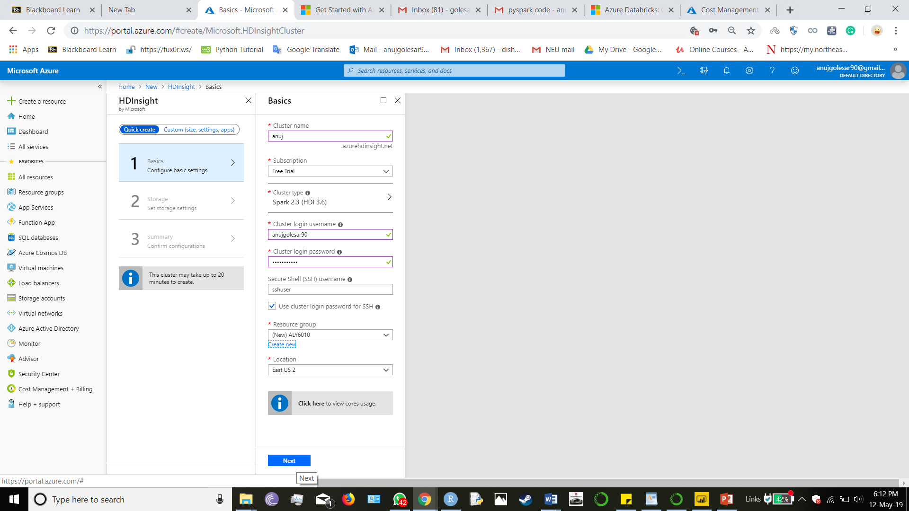
Process
Access Azure platform and Create HDInsights Cluster
Azure HDInsight is a cloud-based service from Microsoft for big data analytics that helps organizations process large amounts of streaming or historical data.
Quickly spin up big data clusters on demand, scale them up or down based on your usage needs
Security Offerings
Integrated Environment

Slide 6
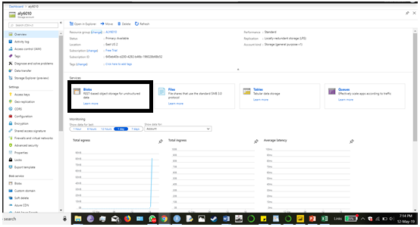
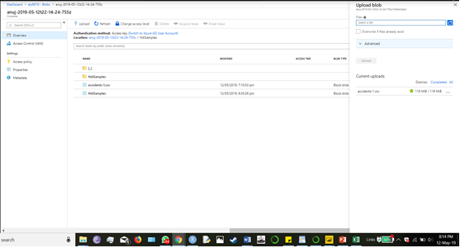
Process
After creating HDInsight cluster , uploaded the data on Azure Blob Storage
Select Blob Storage
Upload data stored on local disk on cloud

Slide 7
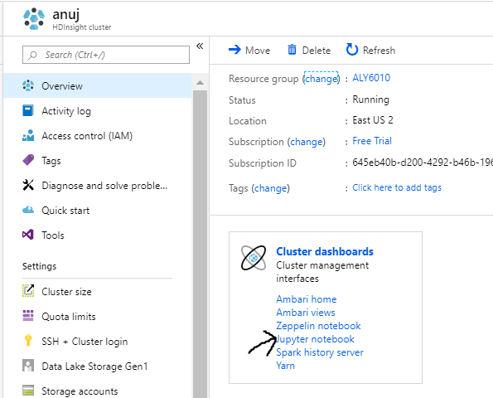
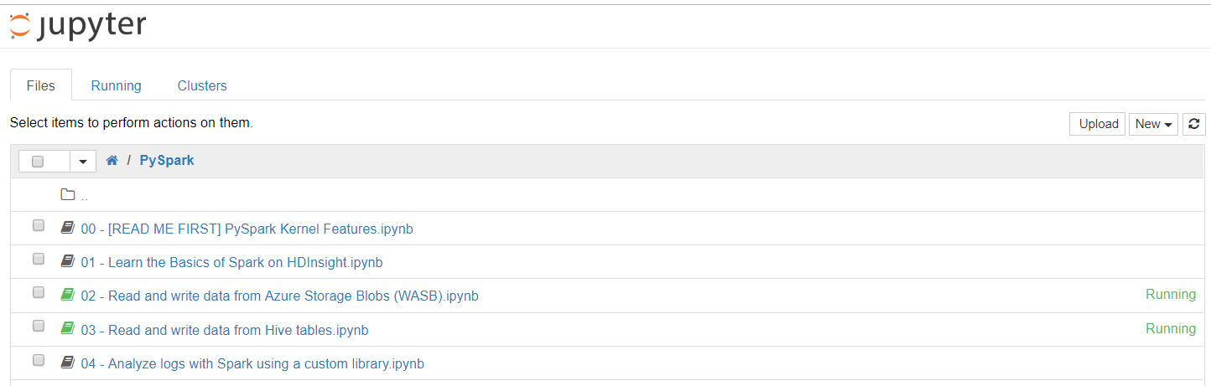
Process
cluster dashboard and select Jupyter notebook and configure it for apache spark. It will navigate to Jupyter home page
Click on new > python

Slide 8
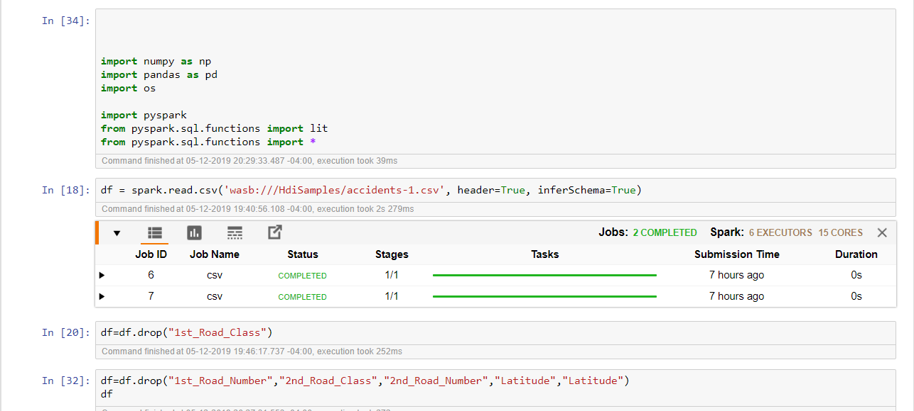
Process
Write the script to clean the data by importing pyspark libraries into jupyter notebook.

Slide 9
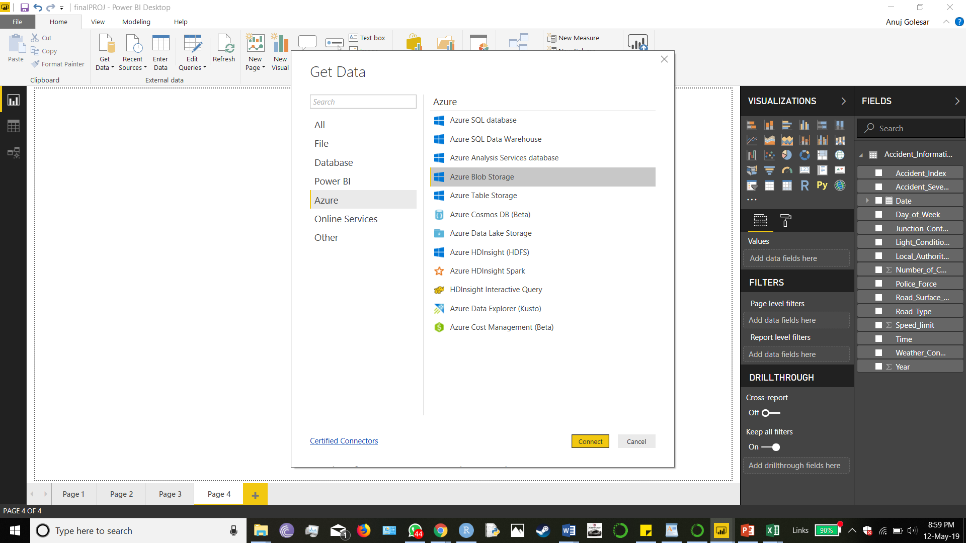
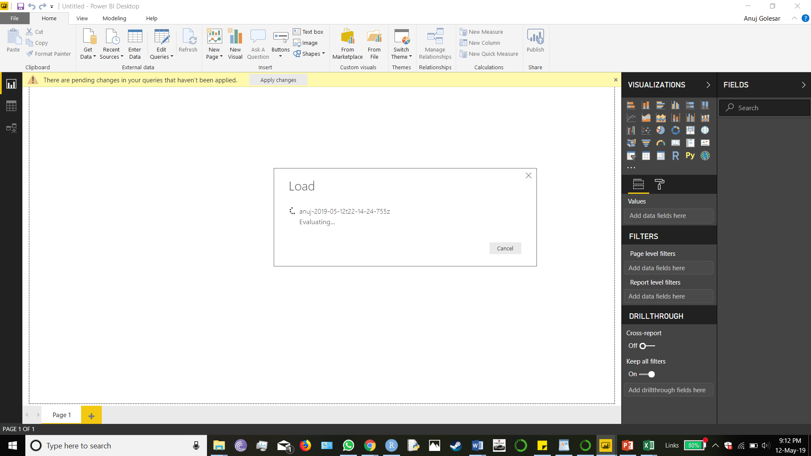
Process
Import the cleaned data from Azure Blob Storage into Power BI to create visualizations using the access key

Slide 10

Results

Slide 11
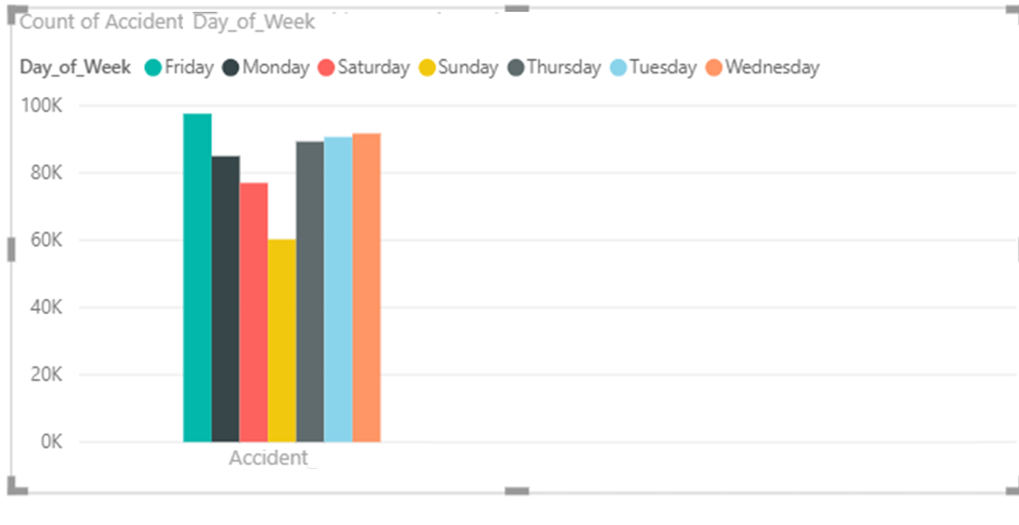

Slide 12
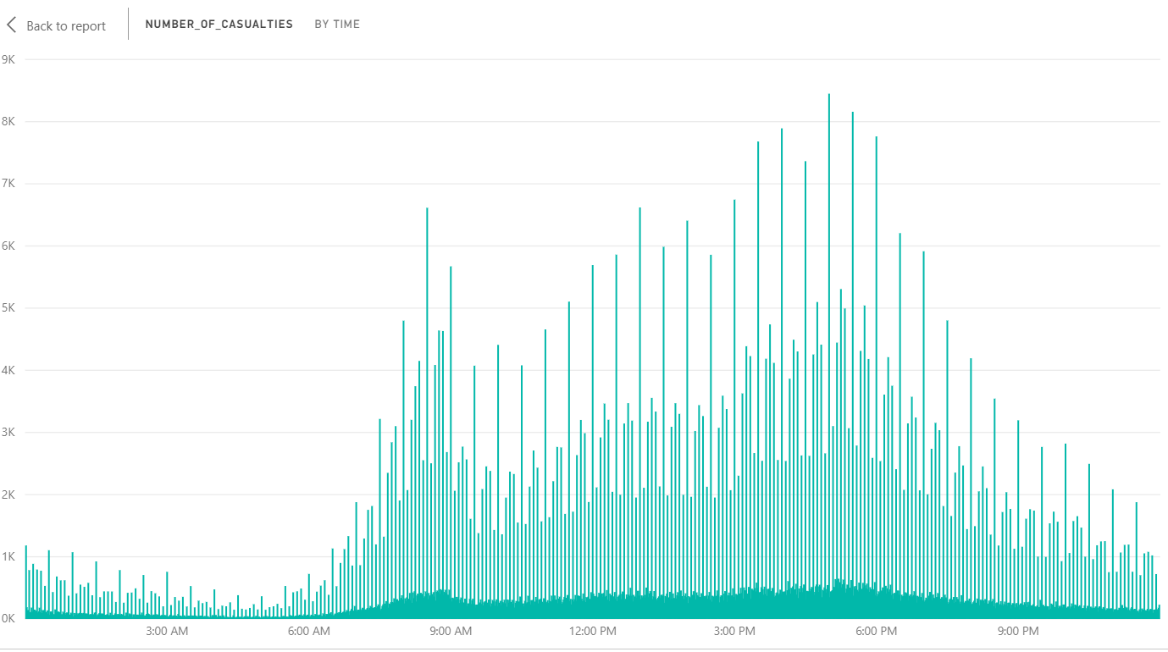
No of casualties by time in a day . It suggest patrolling units and paramedics should be more active during 8am to 9am

Slide 13
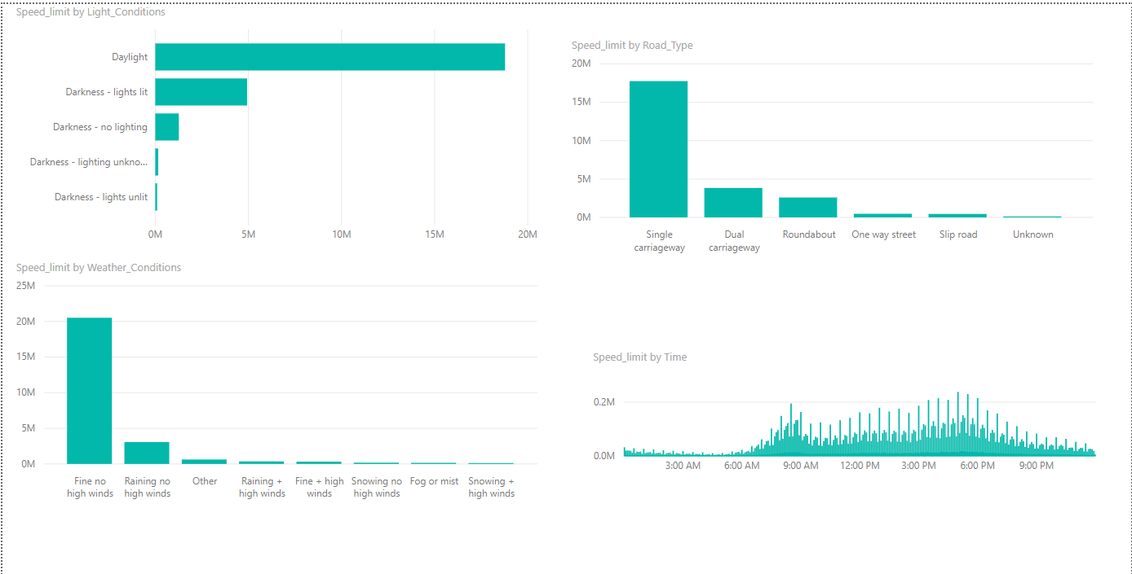
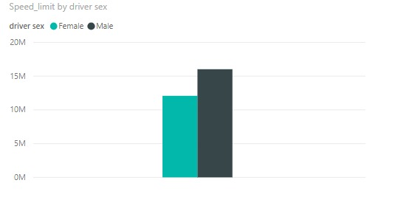

Slide 14
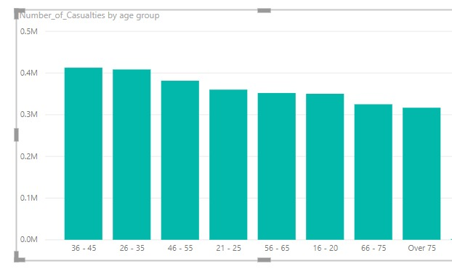
This plot shows the young and working age groups are more likely to victims of the lethal accidents .

Slide 15
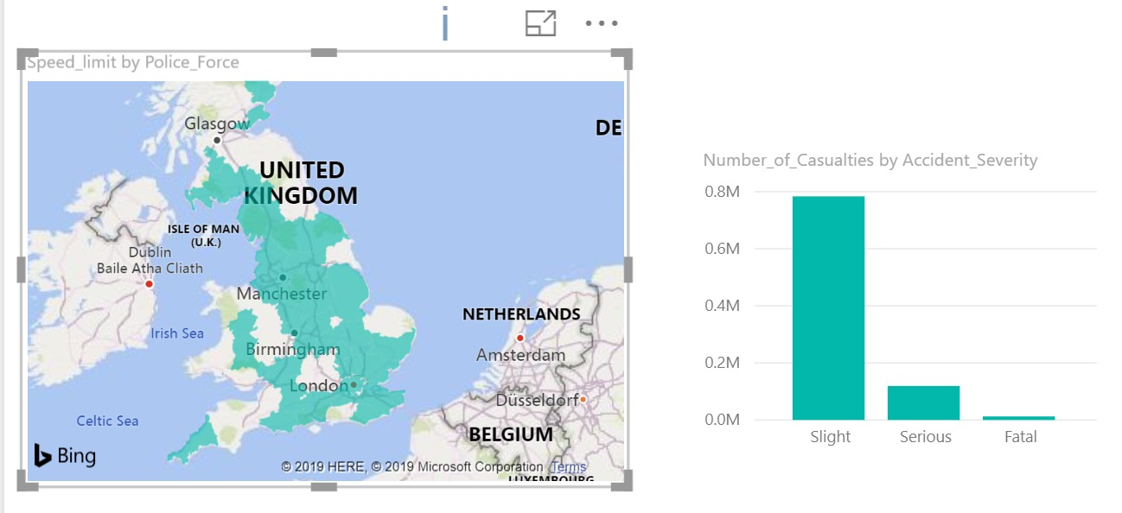
The above plot shows how the severity of the accidents is distributed over the different regions of United
Kingdom.

Slide 16
CONCLUSION
We can infer that there are various important factors such as road conditions , how weather conditions affects driving conditions , the causes of accidents such as not yielding for other drivers needs to be taken seriously by safety authorities
The speed of the vehicle is major factor for accidents in United Kingdom.
The working and young age groups needs to be more careful while driving as these groups are vulnerable to accidents.

Slide 17
REFERENCES:
[1] https://www.qubole.com/resources/pyspark-cheatsheet/
[2]DATASET:https://www.kaggle.com/danofer/uk-accidents-aggregations/data
[3] https://pandas.pydata.org/pandas-docs/stable/reference/api/pandas.DataFrame.drop.html

Slide 18


